Slide 1
Project Week: Red vs. Blue
Project Week 2
1

Slide 2

Welcome to Project Week!
This week, you will embark upon your second project: A Red vs. Blue scenario in which you will play the role of both pentester and SOC analyst.
2
2

Slide 3
Project Week 2
Throughout this week you will:
Day 1
Day 2
Day 3
Work as a red team to apply everything you’ve learned in pen testing to access a vulnerable target.
The target will be capturing logs of the your activity as you attack it.
Work as a Blue Team and use the ELK setup you created in Project 1 .
You will use this to extract hard data and visualizations for your report.
Report and present your log data to suggest mitigation measures for each exploit you successfully performed.

Slide 4
This project requires knowledge of pen testing, SIEM, and system administration.
Gaining such a broad knowledge of cybersecurity tools is a significant achievement.
Congratulations on all you have accomplished so far.

Slide 5
Lab Environment
This lab environment contains an attack VM, a target VM, and an ELK server.
Kali
Capstone
ELK
This is a standard Kali Linux machine for use in the penetration test on Day 1.
Credentials:
Username: root
Password: toor
This is the vulnerable target VM students will attack.
It has Filebeat and Metricbeat installed, and forwards logs to the ELK machine.
This is the same ELK setup that you created in Project 1.
It holds the Kibana dashboards you will use in Day 2.

Slide 6
Day 1: Red Team

Slide 7

ELK Stack Refresher
Logs are collected on deployed machines.
Logs are forwarded to the Elasticsearch database.
Kibana is used to visualize data.
Notes:
shutterstock_1363031105

Slide 8
ELK Stack Refresher
Beats are small programs that run on the machines being monitored and forward logs to the database.
Filebeat collects data about the file system, such as files changed, requested, and uploaded.
Metricbeat collects data about the system, such as uptime and SSH logins.
Packetbeat collects network data, such a incoming and outgoing packets.
Notes:
shutterstock_1363031105

Slide 9
Project Milestones
✓
Day 1: Find the flag on the Capstone VM.
✓
Day 2: Answer all provided questions about the logs captured in Kibana.
Day 3: Complete a presentation summarizing your findings.
✓
9

Slide 10
Day 1 Overview
Today’s activity will require the following high-level steps:
Identify the IP address and exposed services of the target VM.
Find hidden files on the target.
Brute-force and crack passwords to gain entry.
Upload a PHP reverse shell to an insecure web server.
Explore the target system and finding the flag.

Slide 11
Day 1 Activity: Attack!
You will act as an offensive red team and exploit a vulnerable VM.
Full Class Time

Slide 12
Time’s Up
In today’s class, you enumerated, exploited and escalated privileges on a vulnerable VM.
As you were working, the ELK server was recording your actions.
Next class, you will act as a blue team to analyze these logs and determine mitigation strategies.

Slide 13
Day 2: Blue Team

Slide 14
Blue Team Objectives
In Day 1, the red team:
As the blue team, you will find evidence of each of these steps by:
Identified the IP address and exposed services of the target VM.
Found hidden files on the target.
Brute-forced and cracked passwords to gain entry.
Uploaded a PHP reverse shell to an insecure web server.
Explored the target system and found the flag.
Finding data depicting each step of the attack.
Using this data to propose possible alarm metrics and thresholds.
Using this data to propose hardening and mitigation techniques.

Slide 15
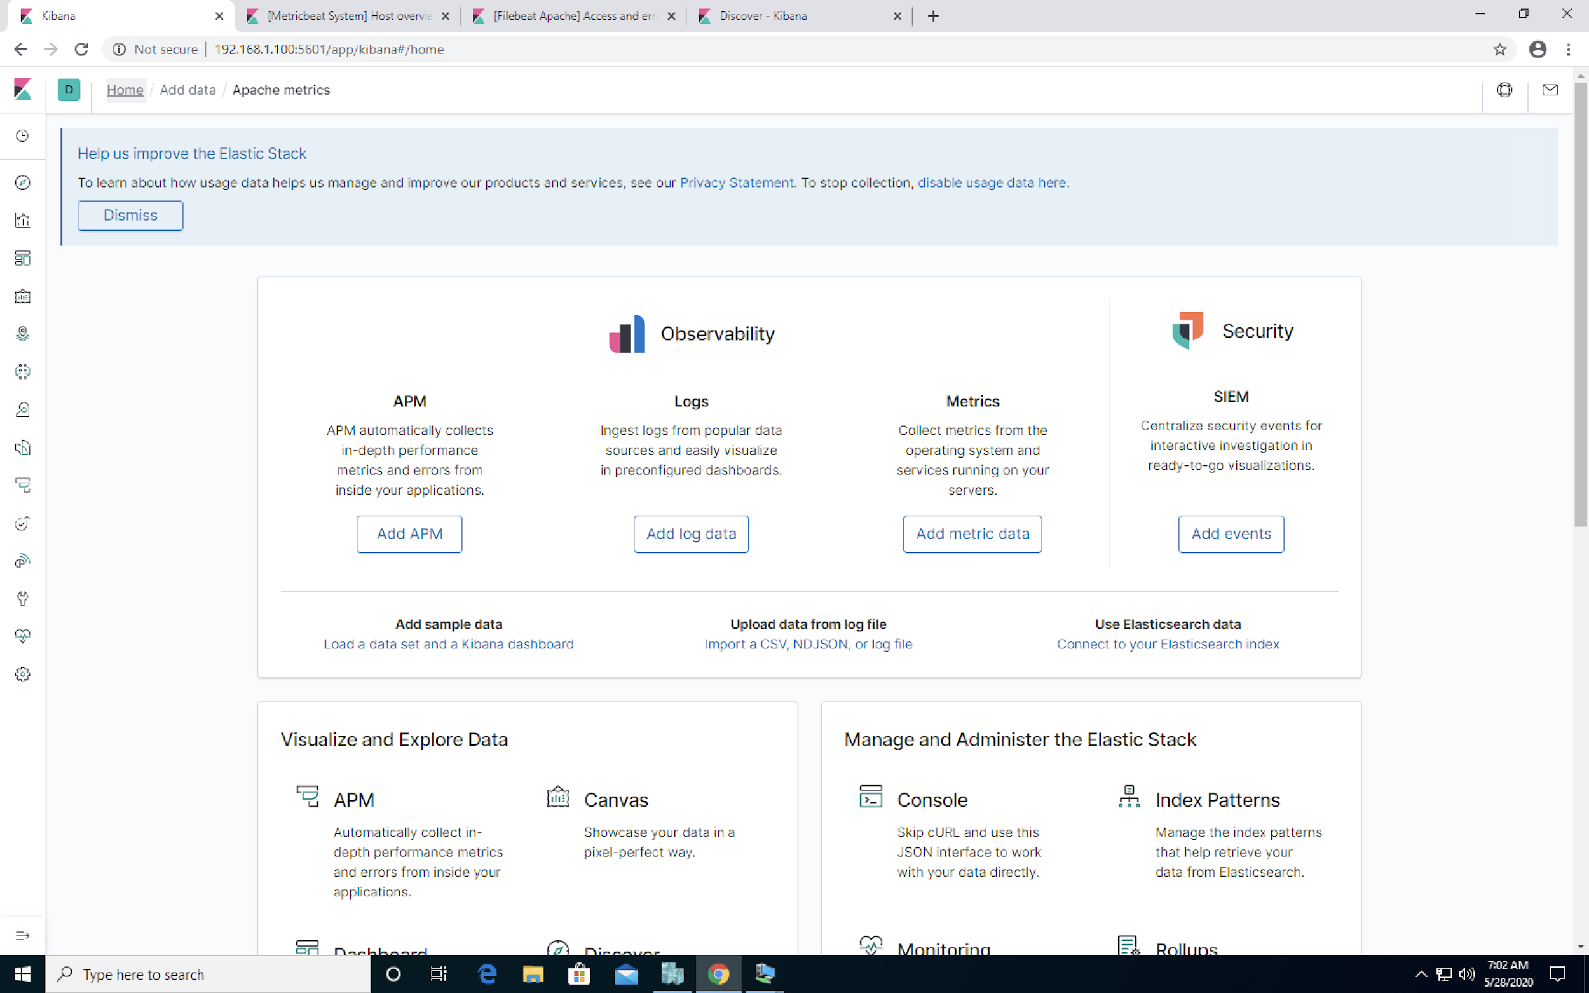
Kibana
The ELK server is configured on your VMs and ready to use. You just need to launch Google Chrome on the Windows host to access it.
Chrome is configured to load the following pages by default:
Kibana homepage
Filebeat system metrics
Filebeat Apache metrics
Packetbeat metrics

Slide 16
Searching Logs in Kibana
We will use the following beats in Kibana:
Filebeat monitors files on disk for changes and watches system events, such as user logins.
Metricbeat monitors system health metrics, such as uptime.
It also generates metrics based on Apache access logs.
Packetbeat captures network data, allowing users to explore packets as they come in.
Packetbeat is like Wireshark for ELK.

Slide 17
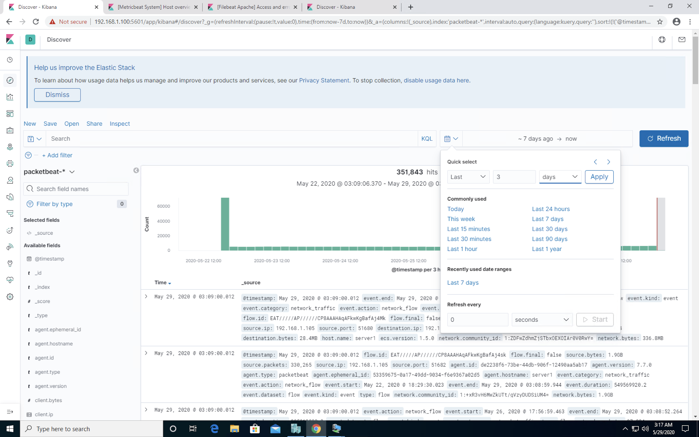
Searching Logs in Kibana
Kibana can provide an overwhelming amount of tools to work with. We will focus on the visualizations and dashboards and Kibana Query Language (KQL).
We can filter for properties such as:
Timestamps
Source and destination IPs and ports
Protocols
URLs

Slide 18
High-Level KQL Walkthrough

Slide 19
Day 2 Activity: Incident Analysis with Kibana
You will use Kibana to analyze logs taken during the red team’s attack. As you analyze, you will use the data to develop ideas for new alerts that could improve your monitoring.
Full Class Time

Slide 20
Time’s Up
In today's class, you used Kibana to analyze the logs that were captured while you performed your penetration test.
Now that you know how much defenders can observe of what you do, you should have clearer insight into how and why attackers and defenders use certain tactics.
You used data to develop ideas for new alarms and ways to harden the vulnerable VM. These can be implemented to improve the monitoring setup and configuration security of the target machine.
Next you will summarize your findings in a Google Slides presentation that you can use in future interviews and feature on sites like LinkedIn.

Slide 21
Day 3: Reporting

Slide 22
In the final day of the project, you will summarize your Day 1 and Day 2 findings in a report.
22
22

Slide 23

You will prepare the report of your findings as a professional presentation. This will be a valuable deliverable to show potential employers, proving knowledge and experience.

Slide 24
You will prepare the report of your findings as a professional presentation. This will be a valuable deliverable to show potential employers, proving knowledge and experience.

Slide 25
Reporting
In the report, you will document the following:
Red Team
Blue Team
Mitigations
Network topology
Engagement overview and outcome
Critical vulnerabilities
Summary of attack
For each phase of the exploitation:
Log evidence of attack
Key findings from evidence
Mitigation techniques for each critical vulnerability.
Suggested alarms and thresholds

Slide 26
Day 3 Activity: Reporting
Today, you will fill out a Google Slides template to create a report of your assessment and log analysis.
Report Template
You will need to make your own copy of the template.
Full Class Time

Slide 27
Don’t forget to complete this report for homework if you don’t finish during class.
Try to make it as presentable and professional as possible. This document can be very valuable for networking with cyber professionals and having a discussion with hiring managers.
27
27

